Slide 1
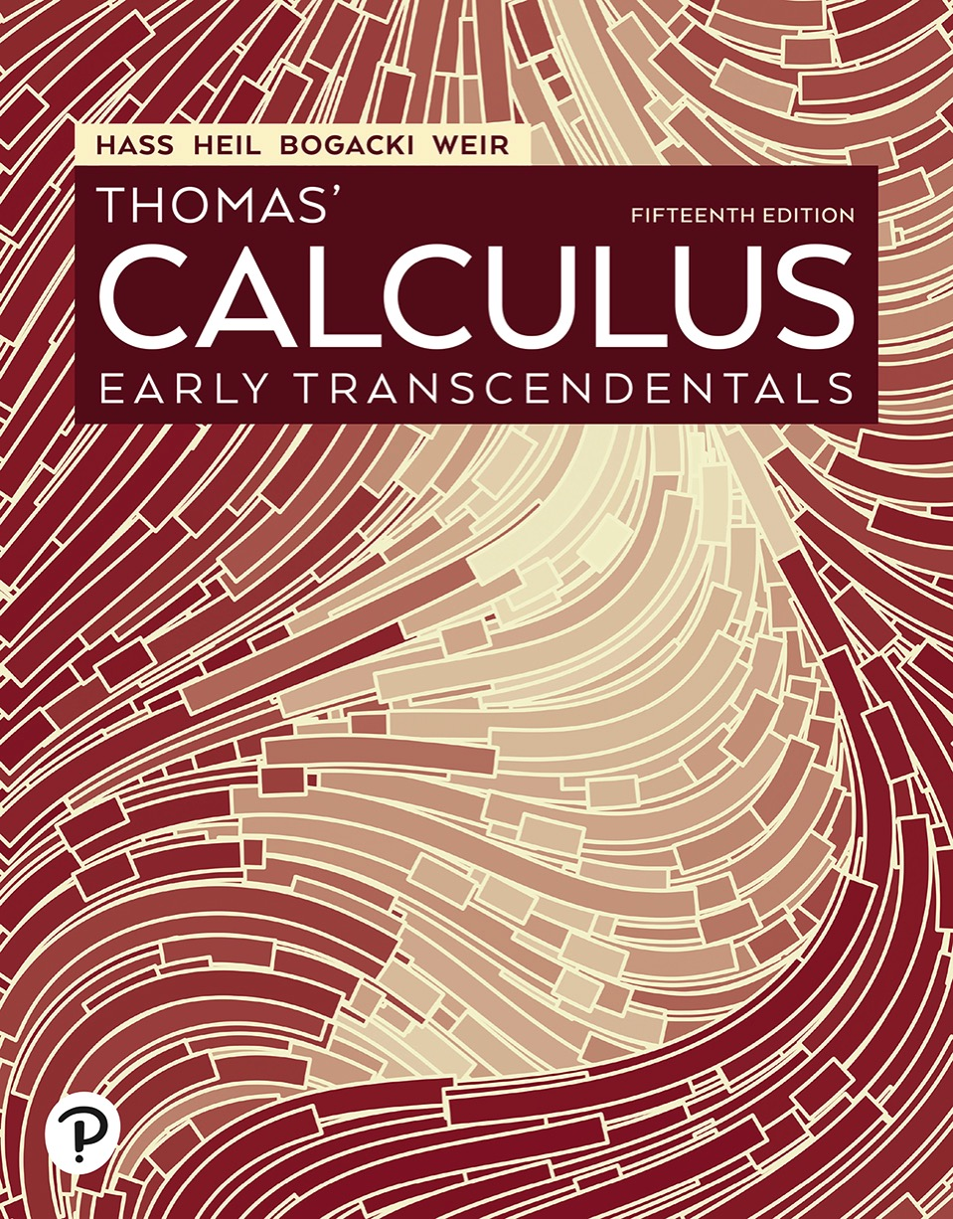

Thomas’ Calculus: Early Transcendentals
Fifteenth Edition
Chapter 14
Partial Derivatives
Copyright © 2023, 2018, 2014 Pearson Education, Inc. All Rights Reserved
Notes:
If this PowerPoint presentation contains mathematical equations, you may need to check that your computer has the following installed:
1) MathType Plugin
2) Math Player (free versions available)
3) NVDA Reader (free versions available)

Slide 2
Section 14.6 Tangent Planes and Differentials

Slide 3
Tangent Planes and Normal Lines (1 of 7)
Definitions: The tangent plane to the level surface
of a differentiable function f at a point
where the gradient is not zero is the plane through
normal to
The normal line of the surface at
is the line through
parallel to

Slide 4
Tangent Planes and Normal Lines (2 of 7)
Tangent Plane to
Normal Line to

Slide 5
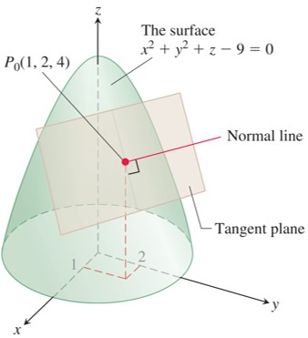
Tangent Planes and Normal Lines (3 of 7)
The tangent plane and normal line to this level
surface at
Notes:
The surface of paraboloid is labeled, x squared + y squared + z minus 9 = 0, and a normal line is perpendicular to the surface at point P sub 0 (1, 2, 4).

Slide 6
Tangent Planes and Normal Lines (4 of 7)
Example: Find the tangent plane and normal line of the level surface
at the point
Solution:
The tangent plane is the plane through
perpendicular
to the gradient of f at
The gradient is

Slide 7
Tangent Planes and Normal Lines (5 of 7)
Solution (concluded):
The tangent plane is therefore the plane
The line normal to the surface at
is

Slide 8
Tangent Planes and Normal Lines (6 of 7)
Plane Tangent to a Surface
The plane tangent to the surface
of a differentiable function f at the point
is

Slide 9
Tangent Planes and Normal Lines (7 of 7)
Example: Find the plane tangent to the surface
at (0, 0, 0).
Solution: We calculate the partial derivatives of
and use the above Equation:
The tangent plane is therefore
or

Slide 10
Estimating Change in a Specific Direction (1 of 4)
Estimating the Change in f in a Direction u
To estimate the change in the value of a
differentiable function f when we move a small
distance d s from a point
in a particular
direction u, use the formula

Slide 11
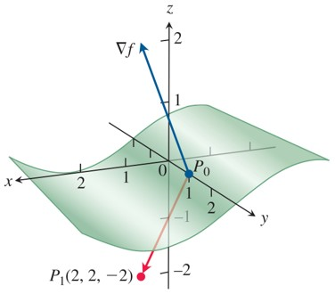
Estimating Change in a Specific Direction (2 of 4)
As
moves off the level surface at
by 0.1
unit directly toward
the function f changes value by
approximately

Slide 12
Estimating Change in a Specific Direction (3 of 4)
Example: Estimate how much the value of
will change if the point
moves 0.1 unit from
straight toward
Solution: We first find the derivative of f at
in the
direction of the vector
The direction of this vector is

Slide 13
Estimating Change in a Specific Direction (4 of 4)
Solution (concluded):
The gradient of f at
is
Therefore,
The change d f in f that results from moving d s = 0.1 unit
away from
in the direction of u is approximately

Slide 14
How to Linearize a Function of Two Variables (1 of 5)
Definitions: The linearization of a function
at a point
where f is differentiable is the function
The approximation
is the standard linear approximation of f at

Slide 15
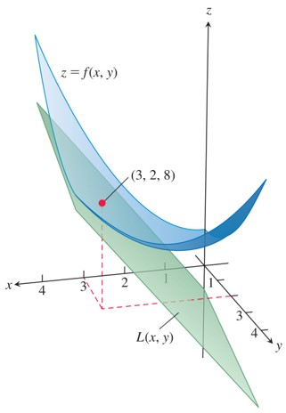
How to Linearize a Function of Two Variables (2 of 5)
The tangent plane
represents the linearization of

Slide 16
How to Linearize a Function of Two Variables (3 of 5)
Example: Find the linearization of
at the point (3, 2).
Solution: We first evaluate
at the point

Slide 17
How to Linearize a Function of Two Variables (4 of 5)
Solution (concluded):
giving
The linearization of f at (3, 2) is
(see Figure).

Slide 18
How to Linearize a Function of Two Variables (5 of 5)
The Error in the Standard Linear Approximation
If f has continuous first and second partial derivatives throughout an open set containing a rectangle R centered at
and if M is any upper bound for the values of
on R, then the error
incurred
in replacing
on R by its linearization
satisfies the inequality

Slide 19
Differentials (1 of 2)
Definition: If we move from
to a point
nearby, the resulting change
in the linearization of f is called the total differential of f.

Slide 20
Differentials (2 of 2)
Example: Suppose that a cylindrical can is designed to have a radius of 1 inch and a height of 5 inches, but that the radius and
height are off by the amounts d r = +0.03 and
Estimate the resulting absolute change in the volume of the can.
Solution: To estimate the absolute change in
we use
With
we get

Slide 21
Functions of More Than Two Variables (1 of 2)
Example: Find the linearization
of
at the point
Find an upper bound for
the error incurred in replacing f by L on the rectangular region
Solution: Routine calculations give
Thus,

Slide 22
Functions of More Than Two Variables (2 of 2)
Solution (concluded):
Since
and
we may take M = 2
as a bound on the second partials. Hence, the error incurred by replacing f by L on R satisfies

Slide 23
Section 14.7 Extreme Values and Saddle Points

Slide 24
Derivative Tests for Local Extreme Values (1 of 17)
Definitions: Let
be defined on a region R
containing the point (a, b).
Then
1.
is a local maximum value of f if
for all domain points (x, y) in an open
disk centered at (a, b).
2.
is a local minimum value of f if
for all domain points (x, y) in an open
disk centered at (a, b).

Slide 25
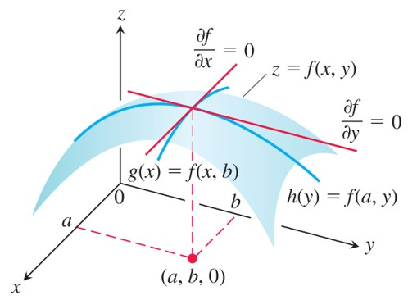
Derivative Tests for Local Extreme Values (2 of 17)
If a local maximum of f occurs at x = a, y = b, then the first
partial derivatives
are both zero.
Notes:
Two curves intersect on the surface of the curve, z = f of x and y. The intersection point of the curves is projected in x y plane at (a, b, 0). The curves are labeled, g of x = f of x and b and h of y = f of a and y. The tangent of the curve, g of x, is labeled, partial derivative of f with respect to x = 0. The tangent of the curve, h of y, is labeled, partial derivative of f with respect to y = 0.

Slide 26
Derivative Tests for Local Extreme Values (3 of 17)
Theorem—First Derivative Test for Local Extreme Values
If
has a local maximum or minimum
value at an interior point (a, b) of its domain and if the first partial derivatives exist there, then

Slide 27
Derivative Tests for Local Extreme Values (4 of 17)
Definition: An interior point of the domain of a
function
where both
are zero or where one or both of
do not exist is a critical point of f.

Slide 28
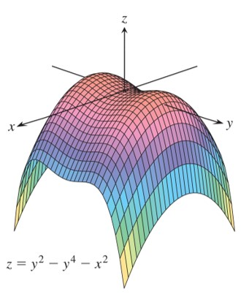
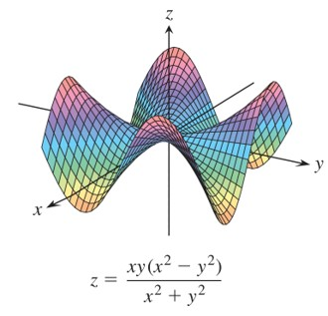
Derivative Tests for Local Extreme Values (5 of 17)
Saddle points at the origin.
Notes:
The curve has a trough in the octants 5, 6, 7, and 8. The curve forms two saddle shapes at its center. An equation below the graph reads, z = start fraction x y left parenthesis x squared minus y squared right parenthesis over x squared + y squared end fraction.
The graph depicts a mound shaped curve that starts in the sixth and seventh octants, grows in the second and third octants, and comes down to touch the origin. The curve rises to the first and fourth octants and finally comes down to the fifth and eighth octants. An equation below the graph reads, z = y squared minus y to the fourth power 4 minus x squared.

Slide 29
Derivative Tests for Local Extreme Values (6 of 17)
Definition: A differentiable function
has a
saddle point at a critical point (a, b) if in every open disk centered at (a, b) there are domain points (x, y)
where
and domain points (x, y)
where
The corresponding point
on the surface
is called a saddle point of the surface.

Slide 30
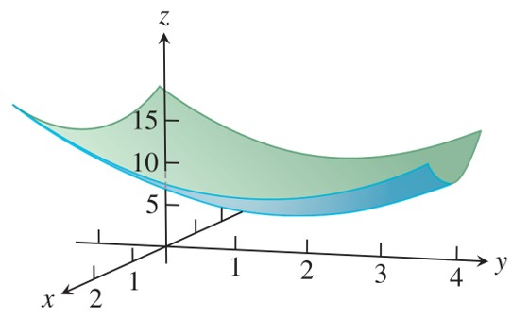
Derivative Tests for Local Extreme Values (7 of 17)
The graph of the function
is a paraboloid which has a local minimum value of 5 at the point (0, 2).

Slide 31
Derivative Tests for Local Extreme Values (8 of 17)
Example: Find the local extreme values of
Solution: The domain of f is the entire plane (so there are
no boundary points) and the partial derivatives
exist everywhere. Therefore, local extreme
values can occur only where
The only possibility is the point (0, 2), where the value of f
is 5. Since
is never less than 5,
we see that the critical point (0, 2) gives a local minimum.

Slide 32
Derivative Tests for Local Extreme Values (9 of 17)
Theorem—Second Derivative Test for Local Extreme Values
Suppose that
and its first and second partial
derivatives are continuous throughout a disk centered at
(a, b) and that
Then
f has a local maximum at (a, b) if
at (a, b).
f has a local minimum at (a, b) if
at (a, b).
f has a saddle point at (a, b) if
at (a, b).

Slide 33
Derivative Tests for Local Extreme Values (10 of 17)
the test is inconclusive at (a, b) if
at (a, b). In this case, we must find some other way to determine the behavior of f at (a, b).
The expression
is called the discriminant
or Hessian of f. It is sometimes easier to remember it in determinant form,

Slide 34
Derivative Tests for Local Extreme Values (11 of 17)
Example: Find the local extreme values of the function
Solution: The function is defined and differentiable for all x and y, and its domain has no boundary points. The function therefore has extreme values only at the points where
are simultaneously zero. This leads to
or

Slide 35
Derivative Tests for Local Extreme Values (12 of 17)
Solution (continued):
Therefore, the point
is the only point where f
may take on an extreme value. To see if it does so, we calculate
The discriminant of f at

Slide 36
Derivative Tests for Local Extreme Values (13 of 17)
Solution (concluded):
The combination
tells us that f has a local maximum at
The value of f at this point is

Slide 37
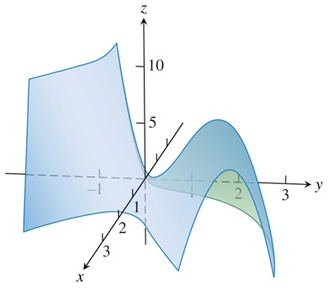
Derivative Tests for Local Extreme Values (14 of 17)
The surface
has a saddle
point at the origin and a local maximum at the point (2, 2).

Slide 38
Derivative Tests for Local Extreme Values (15 of 17)
Example: Find the local extreme values of
Solution: Since f is differentiable everywhere, it can assume extreme values only where
From the first of these equations we find x = y, and substitution for y into the second equation then gives

Slide 39
Derivative Tests for Local Extreme Values (16 of 17)
Solution (continued):
The two critical points are therefore (0, 0) and (2, 2).
To classify the critical points, we calculate the second derivatives:
The discriminant is given by

Slide 40
Derivative Tests for Local Extreme Values (17 of 17)
Solution (concluded):
At the critical point (0, 0) we see that the value of the
discriminant is the negative number
so the function
has a saddle point at the origin. At the critical point (2, 2) we see that the discriminant has the positive value 72. Combining this result with the negative value of the second partial
the critical point (2, 2) gives a local maximum
value of

Slide 41
Absolute Maxima and Minima on Closed Bounded Regions (1 of 8)
1. List the interior points of R where f may have local maxima and minima and evaluate f at these points. These are the critical points of f.
2. List the boundary points of R where f has local maxima and minima and evaluate f at these points. We show how to do this in the next example.
3. Look through the lists for the maximum and minimum values of f. These will be the absolute maximum and minimum values of f on R.

Slide 42
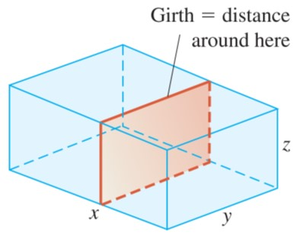
Absolute Maxima and Minima on Closed Bounded Regions (2 of 8)
The box in the Example.

Slide 43
Absolute Maxima and Minima on Closed Bounded Regions (3 of 8)
Example: A delivery company accepts only rectangular boxes the sum of whose length and girth (perimeter of a cross-section) does not exceed 108 inches. Find the dimensions of an acceptable box of largest volume.
Solution: Let x, y, and z represent the length, width, and height of the rectangular box, respectively. Then the girth is 2 y + 2 z. We want to maximize the volume V = x y z of the box satisfying x + 2 y + 2 z = 108. Thus, we can write the volume of the box as a function of two variables:

Slide 44
Absolute Maxima and Minima on Closed Bounded Regions (4 of 8)
Solution (continued):
Setting the first partial derivatives equal to zero,
gives the critical points (0, 0), (0, 54), (54, 0), and (18, 18). The volume is zero at (0, 0), (0, 54), and (54, 0), which are not maximum values. At the point (18, 18), we apply the Second Derivative Test:

Slide 45
Absolute Maxima and Minima on Closed Bounded Regions (5 of 8)
Solution (continued):
Then
Thus,
and

Slide 46
Absolute Maxima and Minima on Closed Bounded Regions (6 of 8)
Solution (concluded):
so (18, 18) gives a maximum volume. The
dimensions of the package are
inches, y = 18 inches, and
z = 18 inches. The maximum volume is

Slide 47
Absolute Maxima and Minima on Closed Bounded Regions (7 of 8)
Summary of Max-Min Tests
The extreme values of
can occur only at
boundary points of the domain of f
critical points (interior points where
or points where
fails to exist)
If the first- and second-order partial derivatives of f are continuous throughout a disk centered at a point (a, b) and
the nature of
can be tested with the Second Derivative Test:

Slide 48
Absolute Maxima and Minima on Closed Bounded Regions (8 of 8)
local maximum
local minimum
saddle point
test is inconclusive

Slide 49

Copyright
This work is protected by United States copyright laws and is provided solely for the use of instructors in teaching their courses and assessing student learning. Dissemination or sale of any part of this work (including on the World Wide Web) will destroy the integrity of the work and is not permitted. The work and materials from it should never be made available to students except by instructors using the accompanying text in their classes. All recipients of this work are expected to abide by these restrictions and to honor the intended pedagogical purposes and the needs of other instructors who rely on these materials.

